Slide 1
Introduction to Data Definition Language
DDL
(Create, Alter ,Drop, Rename, Truncate)

Slide 2
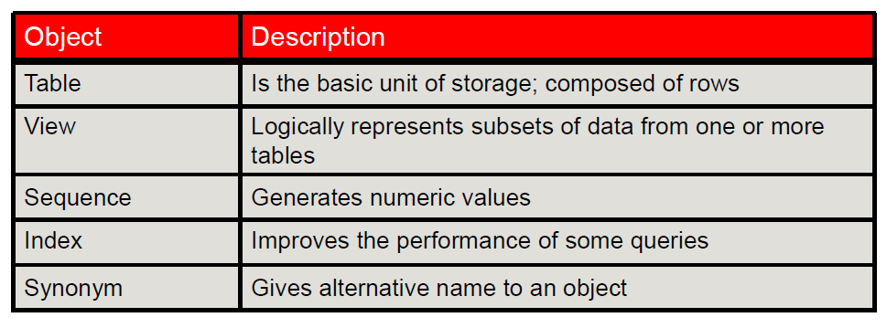
Some Database Objects

Slide 3
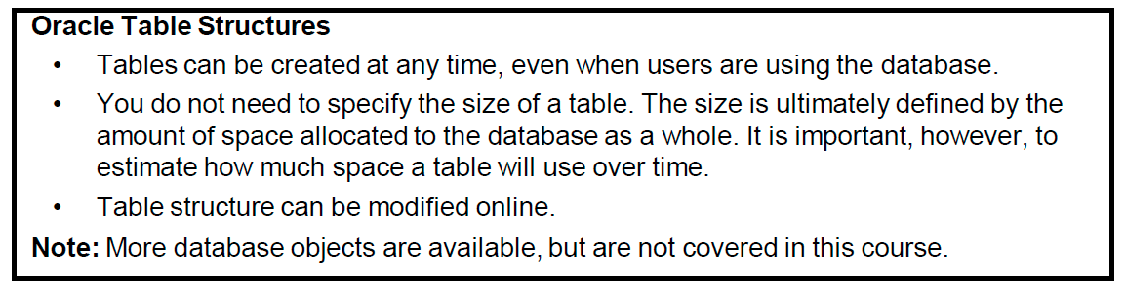

Slide 4
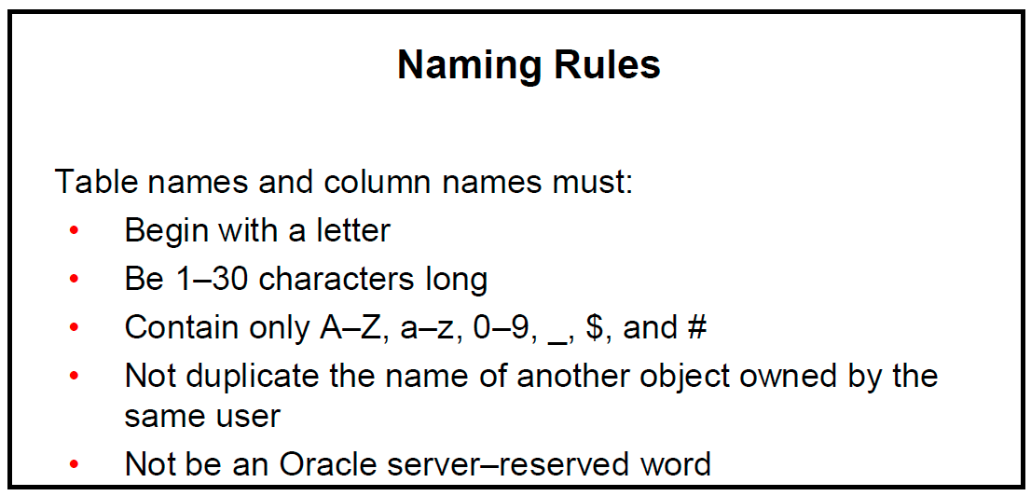

Slide 5
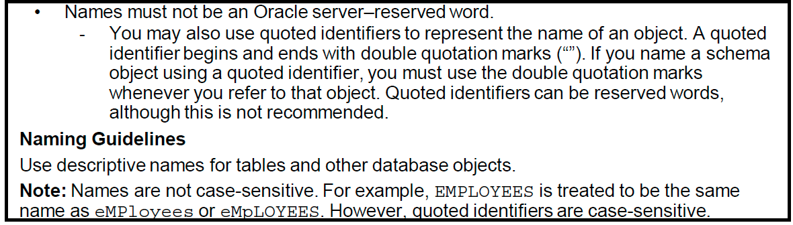

Slide 6
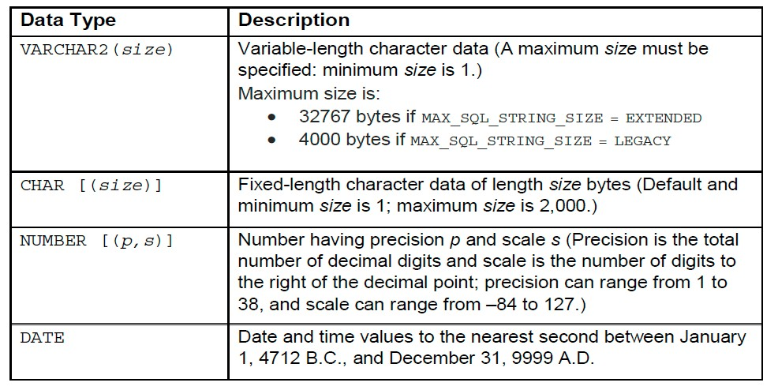
Data Types

Slide 7
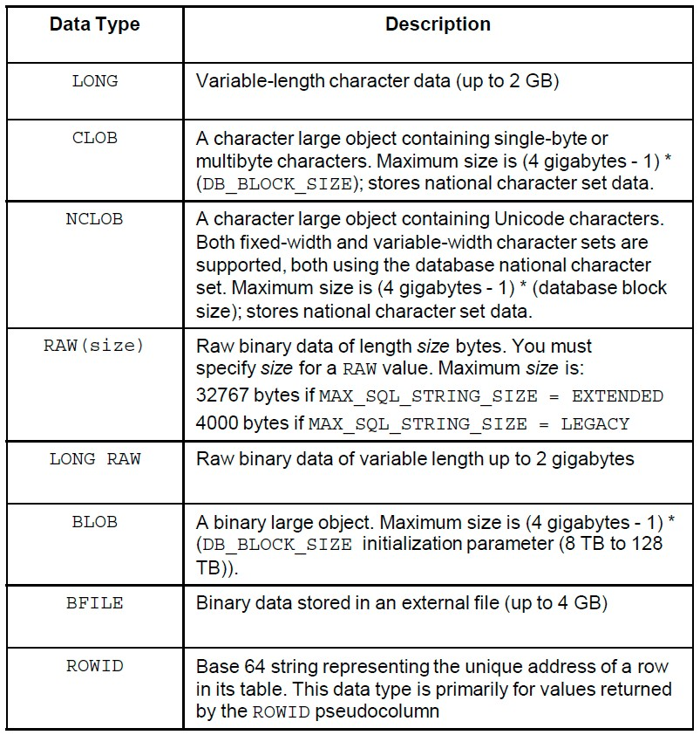

Slide 8
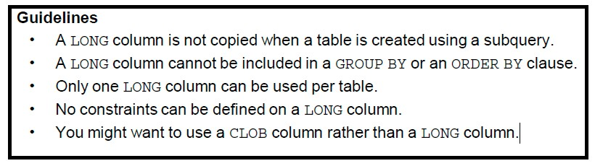

Slide 9
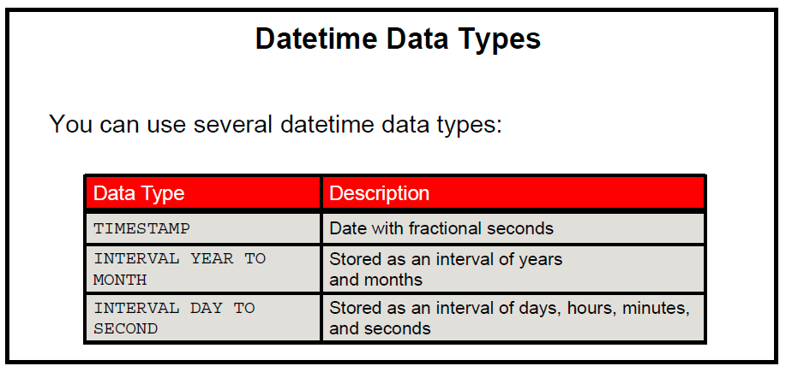

Slide 10
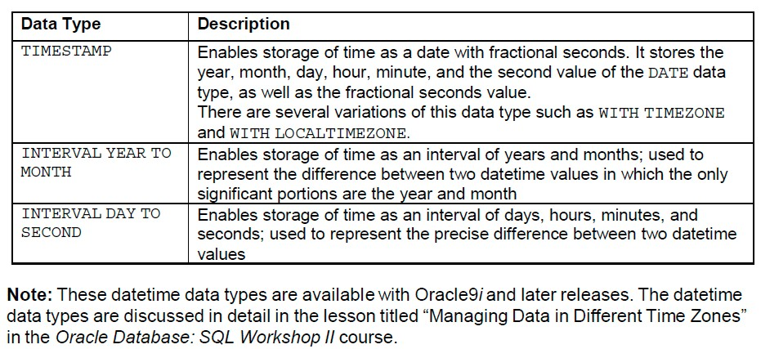

Slide 11
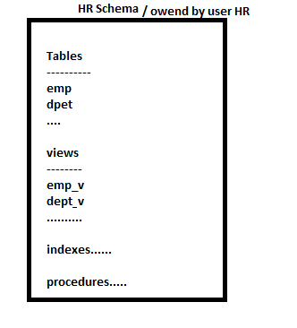
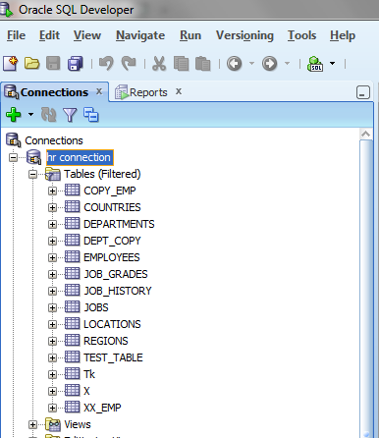
What is the Schema?
A schema is a collection of logical structures of data, or schema objects. A schema is owned by a database user and has the same name as that user. Each user owns a single schema. Schema objects can be created and manipulated with SQL.

Slide 12
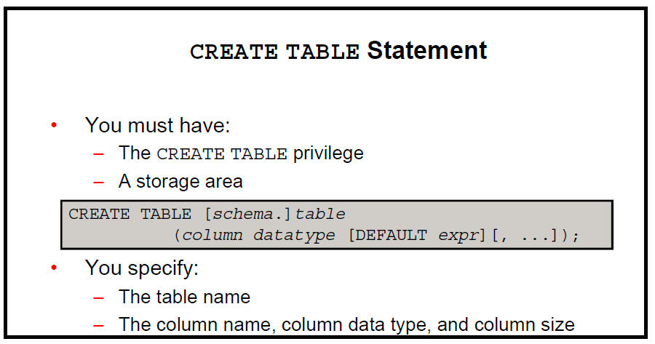

Slide 13
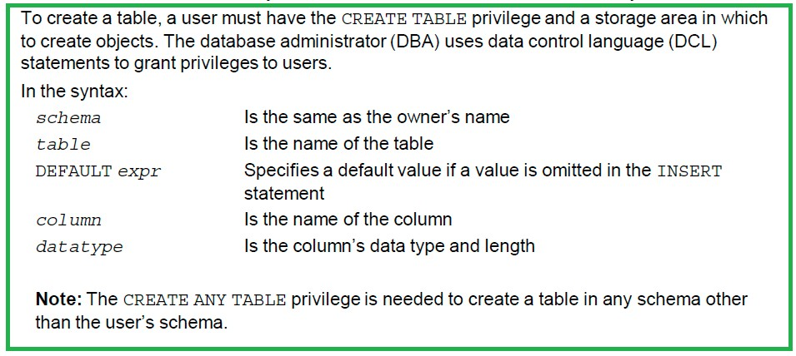

Slide 14
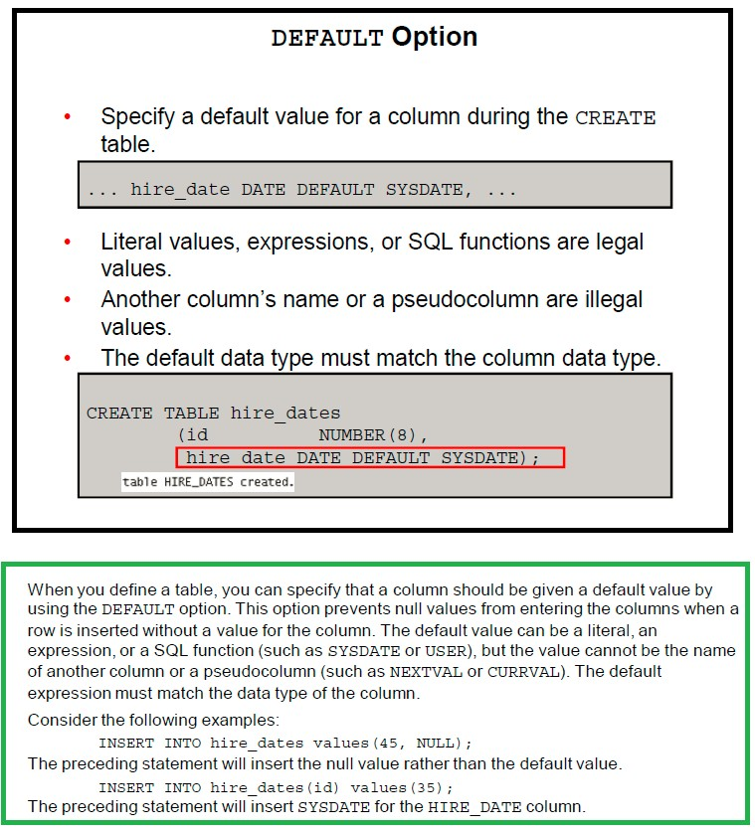

Slide 16
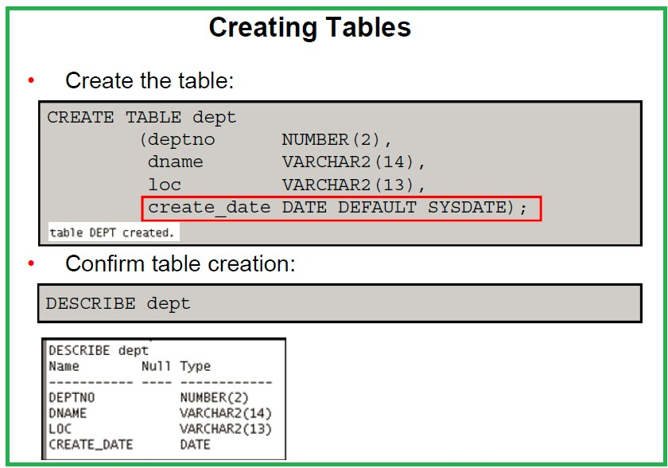

Slide 17
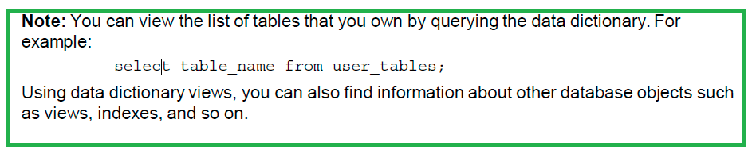

Slide 18
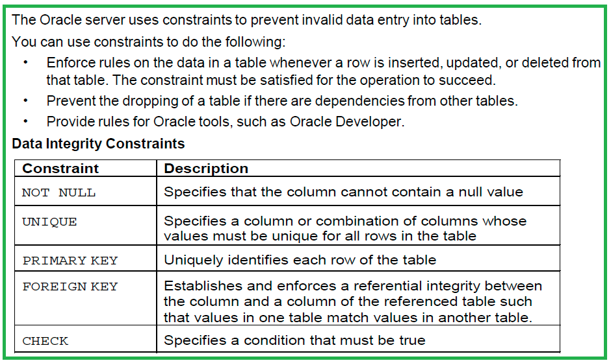
Including Constraints

Slide 19
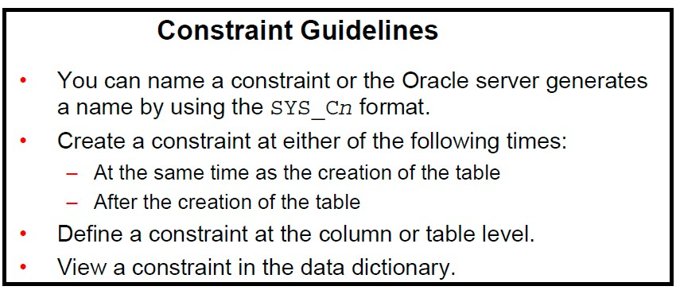

Slide 20
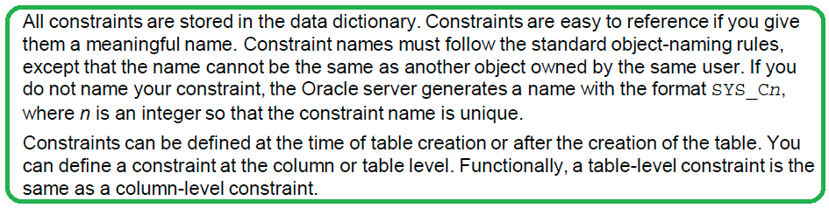

Slide 21
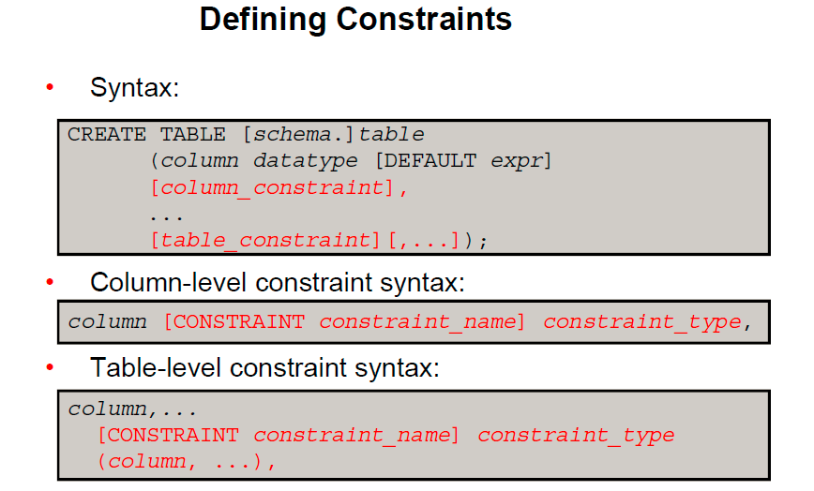

Slide 22
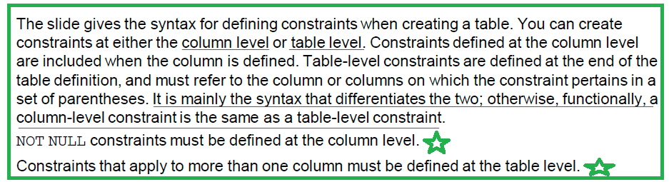

Slide 23
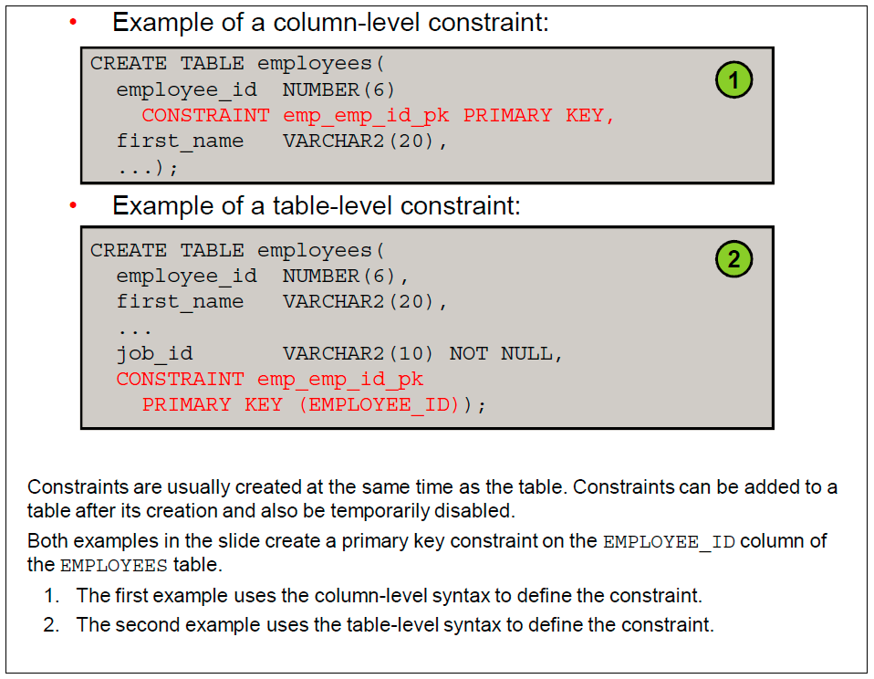

Slide 24
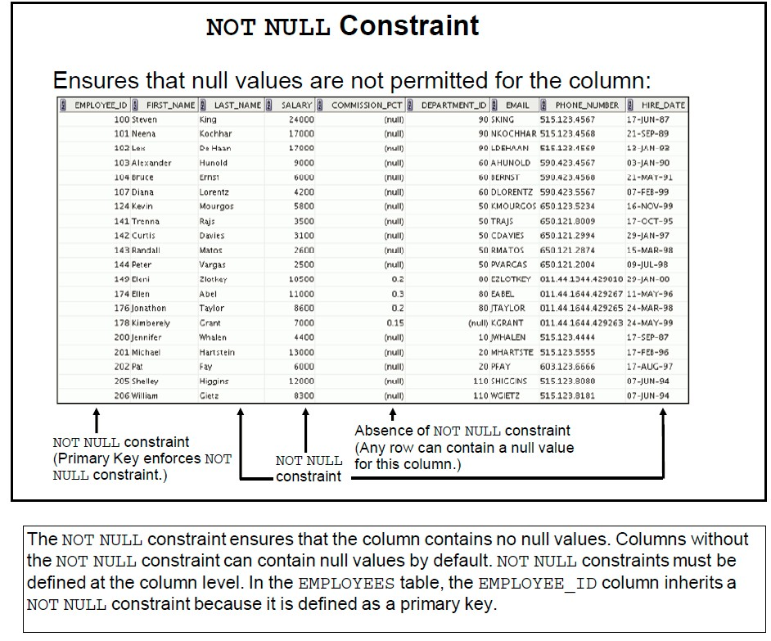

Slide 25
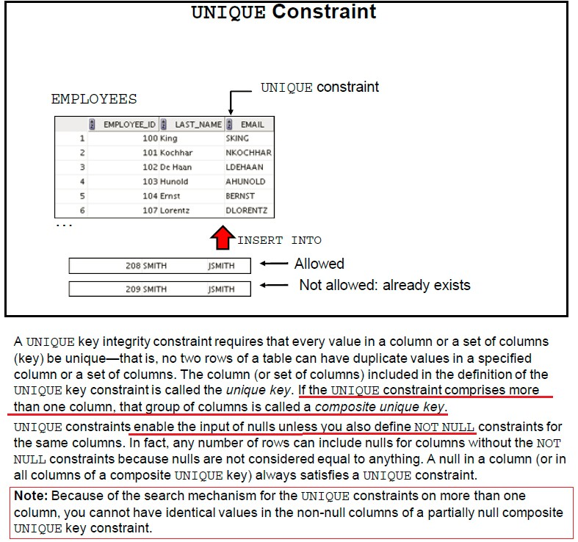

Slide 26
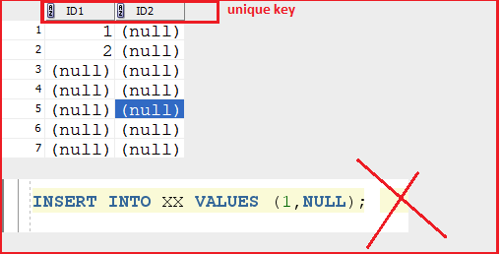

Slide 27
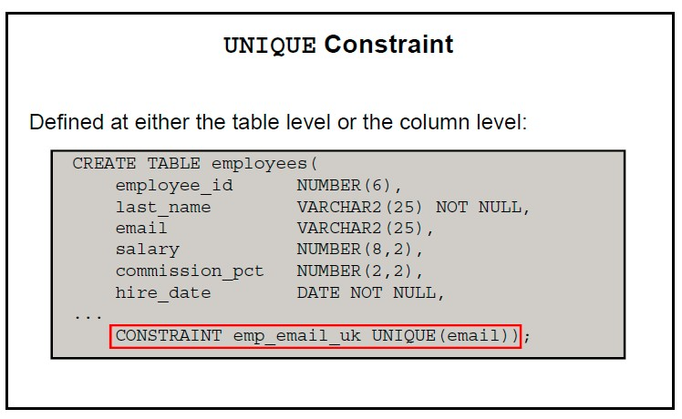
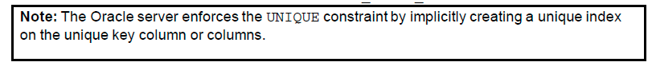

Slide 28
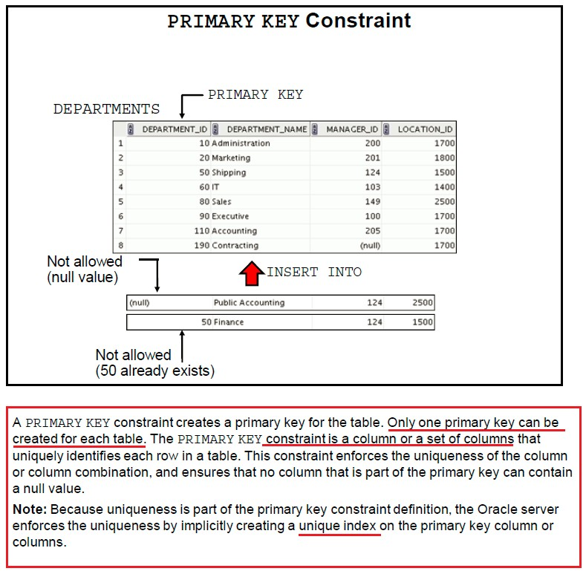

Slide 30
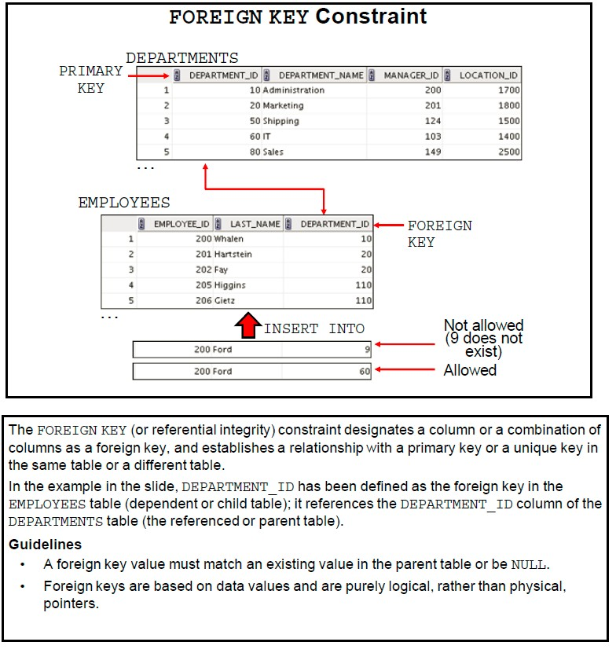

Slide 32
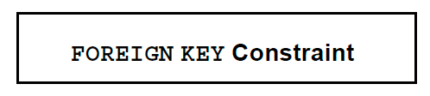
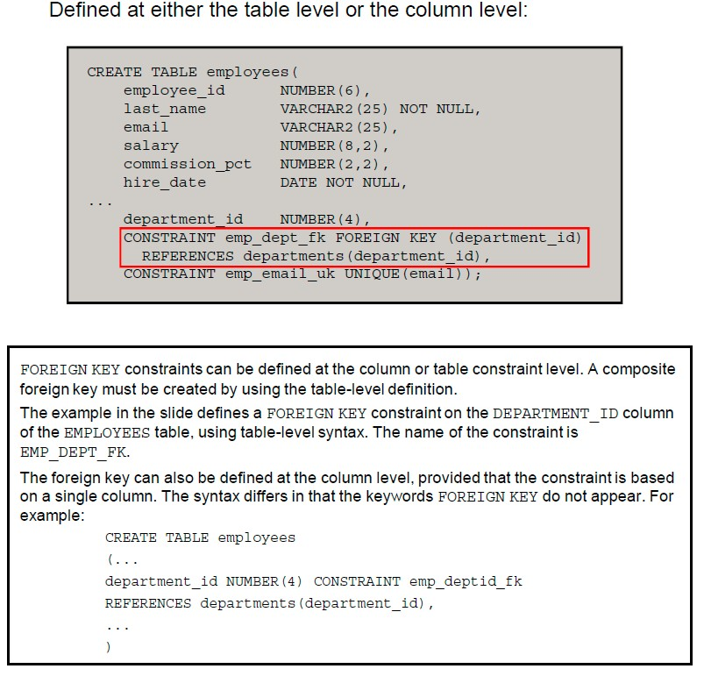

Slide 34

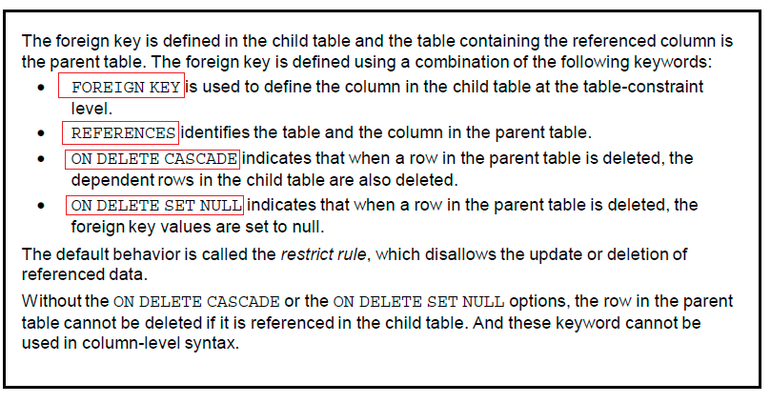

Slide 35
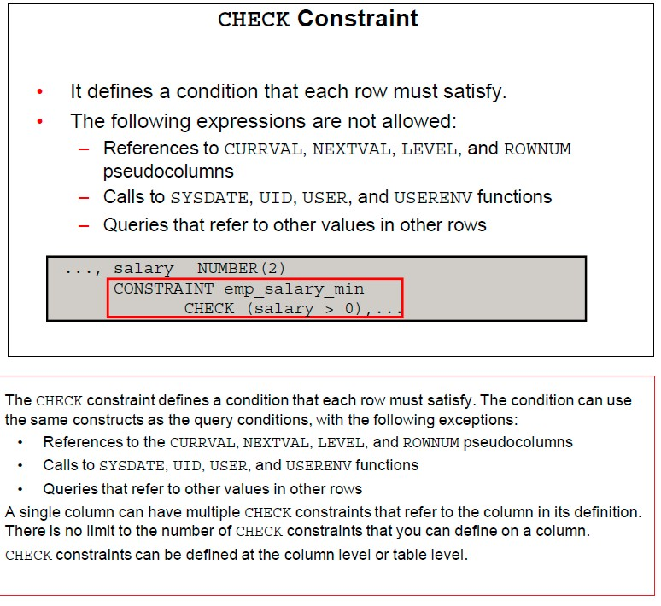

Slide 37
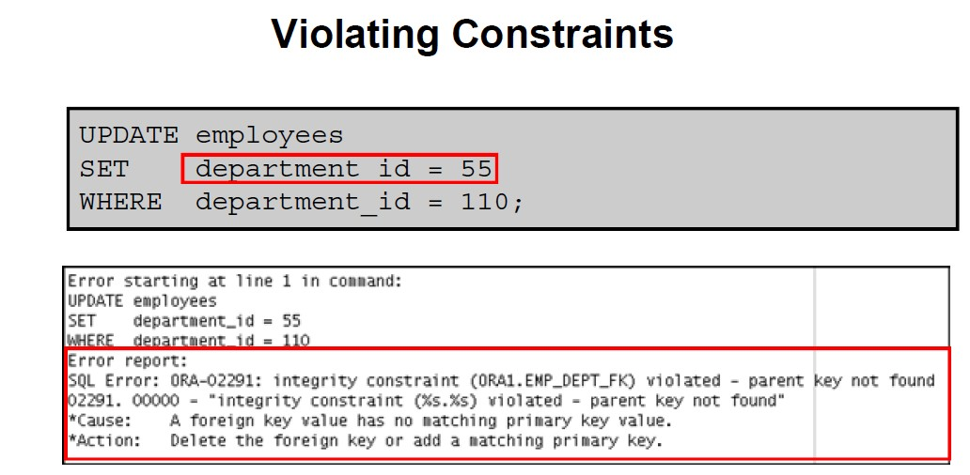
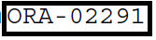

Slide 38
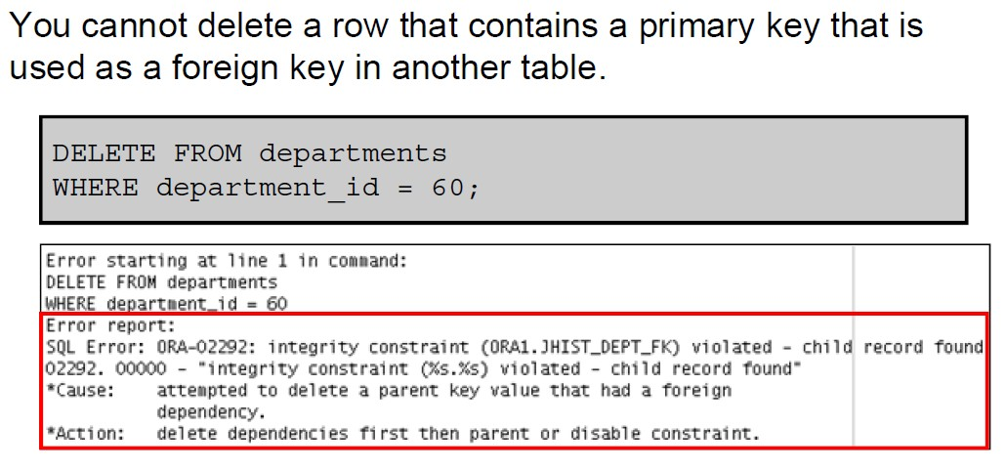
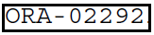

Slide 39
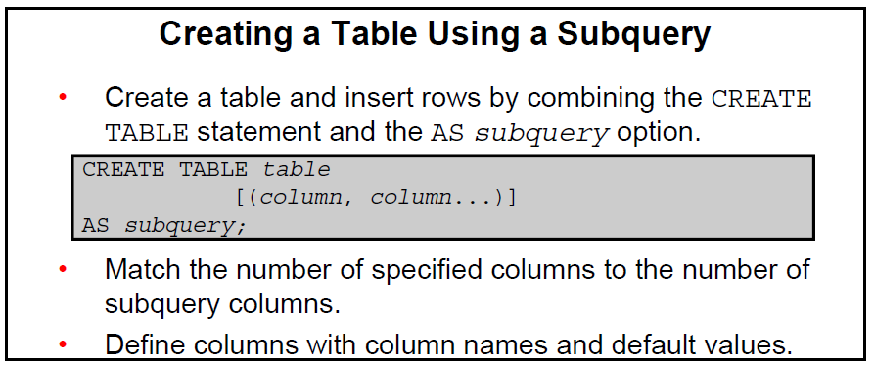

Slide 40
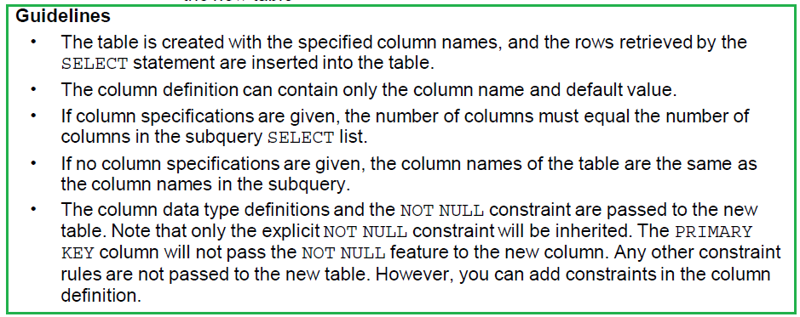

Slide 41
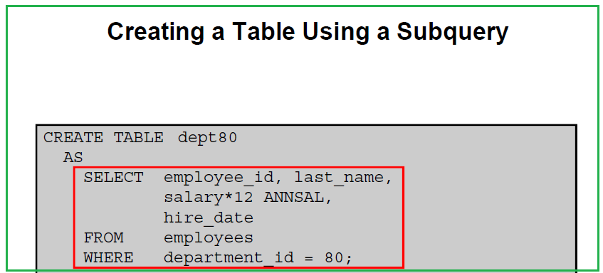
When you use expression you should use Column alias

Slide 42
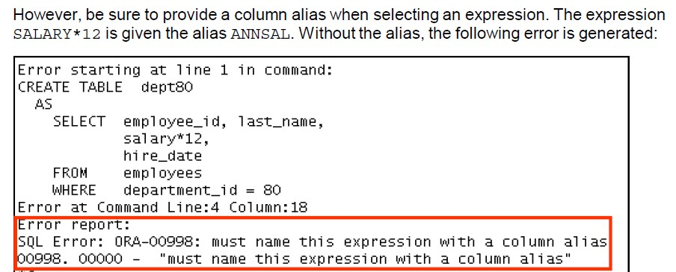

Slide 43
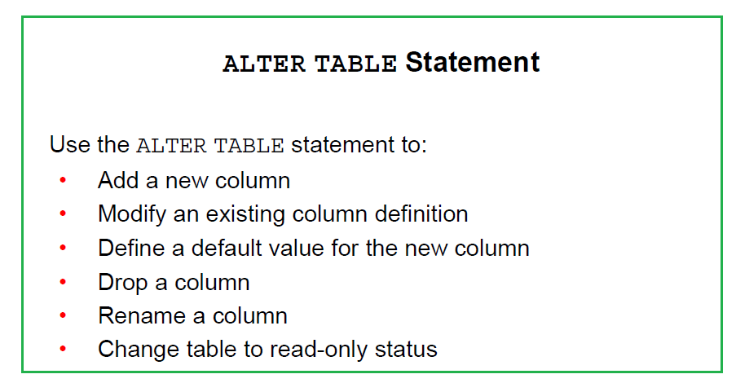
Also we use alter table to:
Add new constraint to the table
Disable constraint in the table
Drop constraint from the table

Slide 44
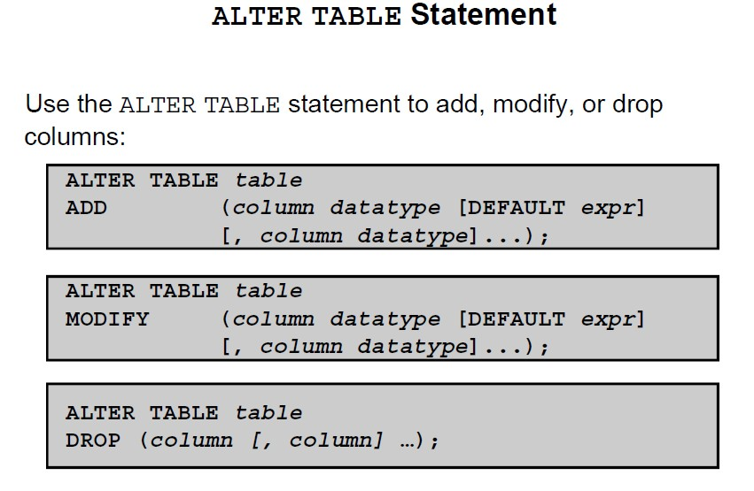
Another syntax for drop is using DROP column ALTER TABLE E_EMP
drop column CREATED_BY; (one column at a time )

Slide 45
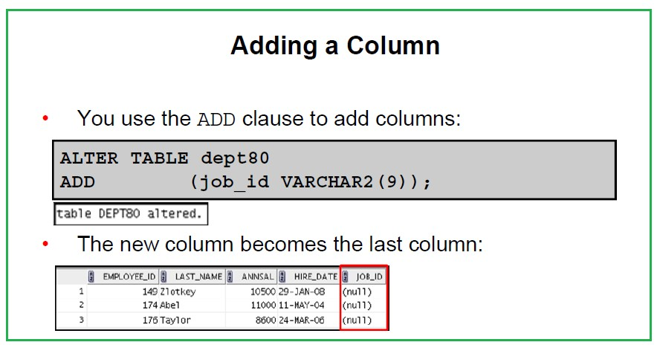

Slide 46
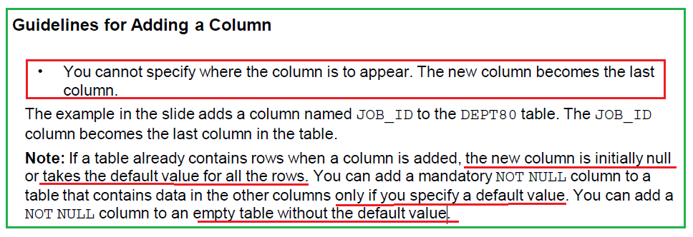

Slide 47
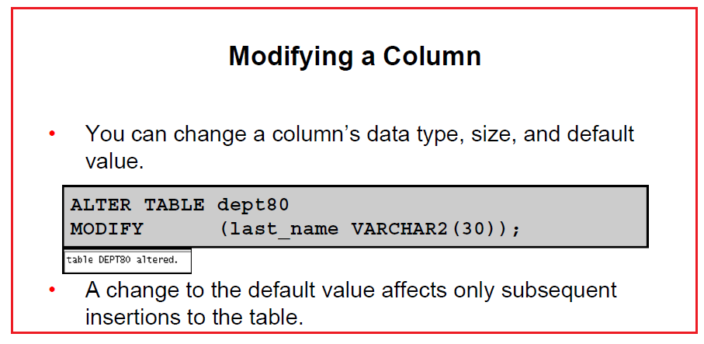

Slide 48
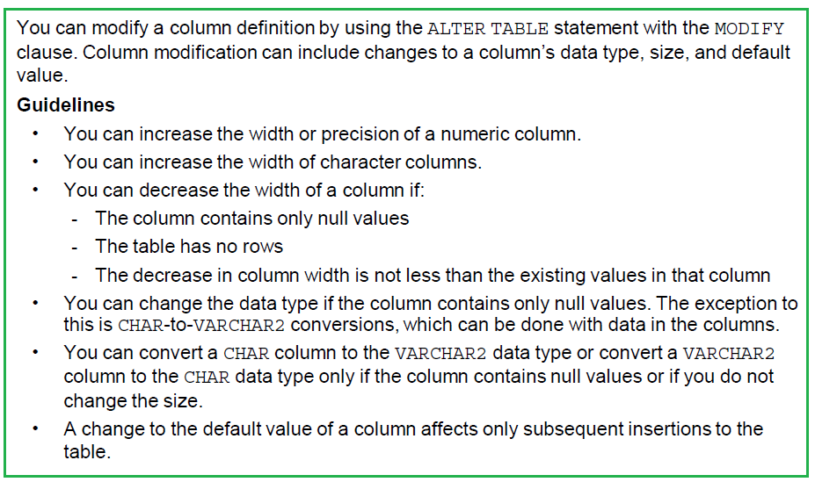

Slide 49
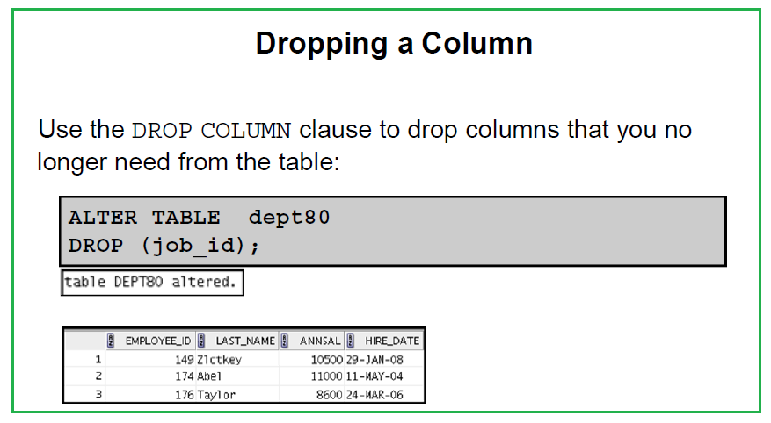

Slide 50
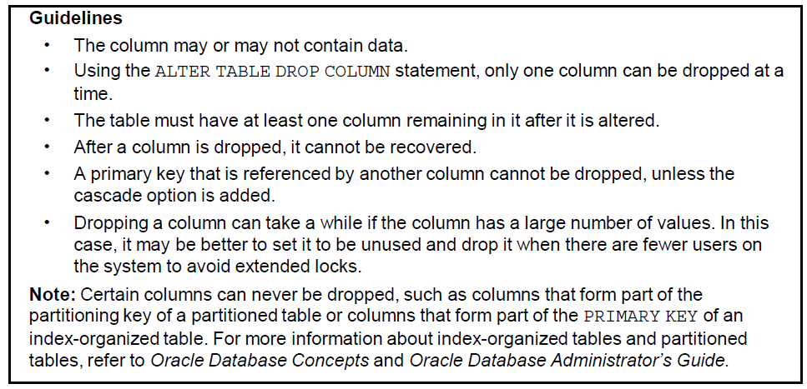

Slide 51
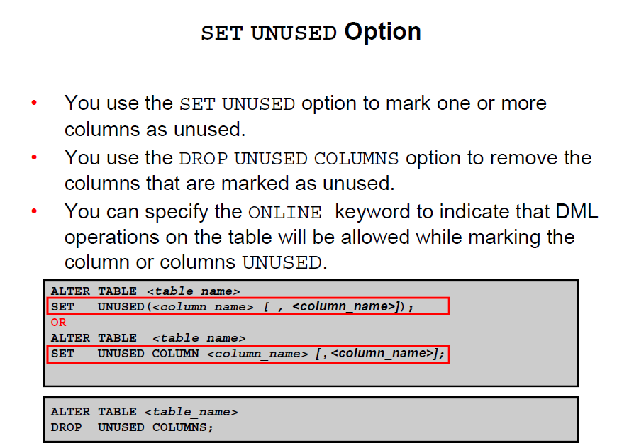

Slide 52


Slide 53


Slide 54


Slide 55


Slide 56


Slide 57


Slide 58
Oracle Database 10g introduces a new feature for dropping tables.
When you drop a table, the database does not immediately release the space associated with the table. Rather, the database renames the table and places it in a recycle bin, where it can later be recovered with the FLASHBACK TABLE statement
If you want to immediately release the space associated with the table at the time you issue the DROP TABLE statement, then include the PURGE clause as follows.

Slide 59
DROP TABLE employees PURGE; Specify PURGE only if you want to drop the table and release the space associated with it in a single step. If you specify PURGE, then the database does not place the table and its dependent objects into the recycle bin. NOTE: You cannot roll back a DROP TABLE statement with the PURGE clause, and you cannot recover the table if you drop it with the PURGE clause. This feature was not available in earlier releases.
https://docs.oracle.com/cd/B28359_01/server.111/b28286/statements_9012.htm

Slide 60
Thank You
Prepared By :Khaled AlKhudari
37

